Slide 1
Python

Slide 2
Course content
What is python
Installations of Python
Python shell
Variables and datatypes
Strings, Lists, Tuples
Input output.
Python blocks
If conditions
For loops

Slide 3
Course content
What is python
Installations of Python
Python shell
Variables and datatypes
Strings, Lists, Tuples
Python Libraries ,pip
Python Db Connection

Slide 4
What is python
Python is a high-level, general-purpose programming language
Python supports Both Object oriented programming and procedure oriented programming
Python is a computer programming language often used to build websites and software, automate tasks, and conduct data analysis.

Slide 5
Python Installations
Link to download for windows (https://www.python.org/ftp/python/3.10.4/python-3.10.4-amd64.exe)

Slide 6
Course content
What is python
Installations of Python
Python shell
Variables and datatypes
Strings, Lists, Tuples
Python Libraries ,pip
Python Db Connection

Slide 7
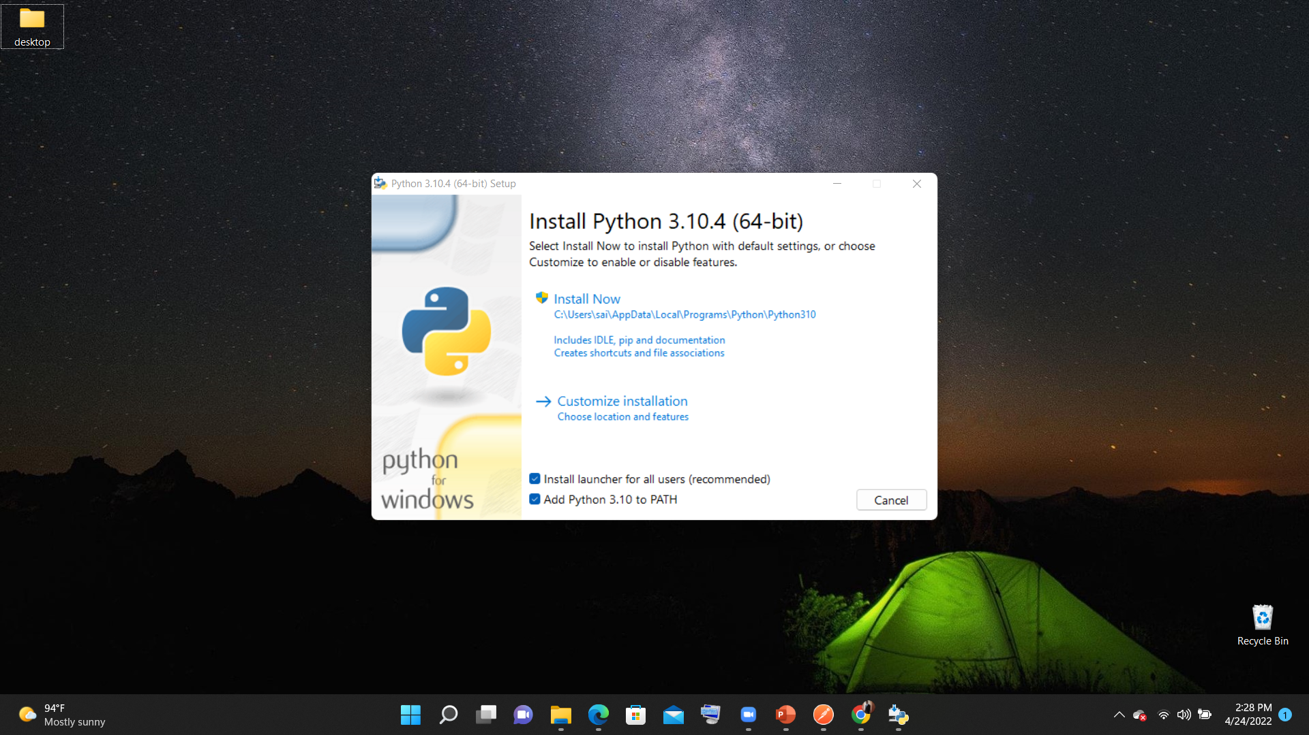

Slide 8
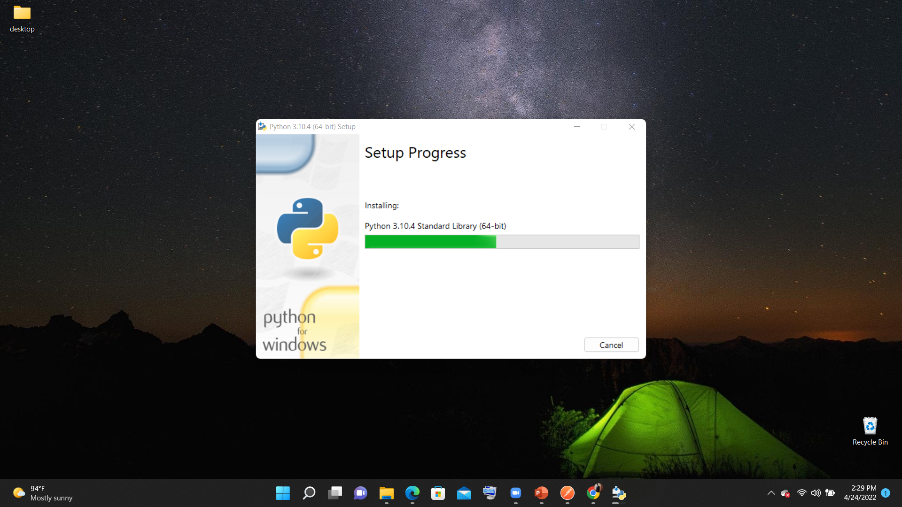

Slide 9
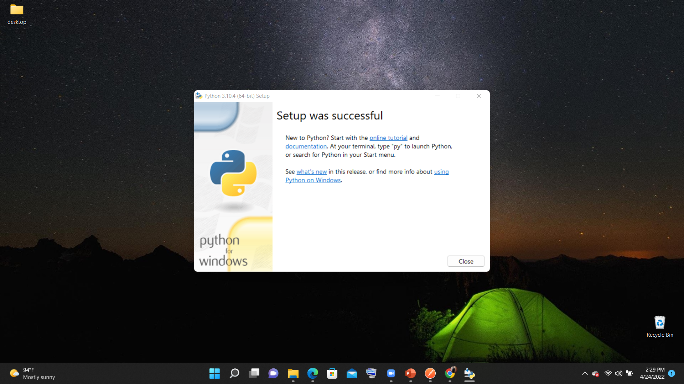

Slide 10
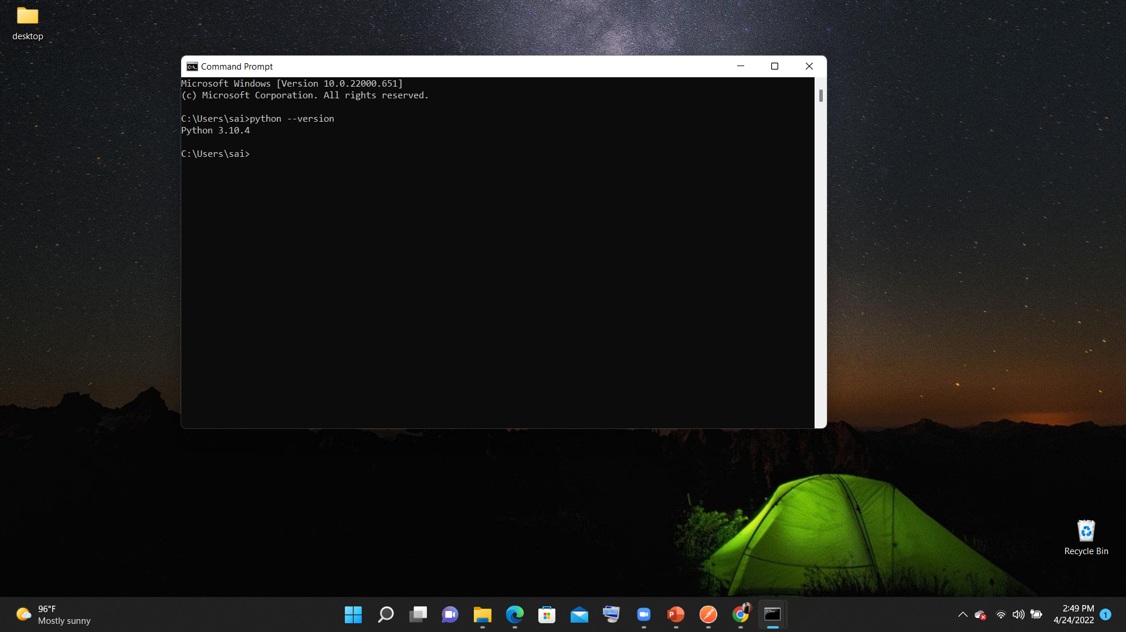
Verify Installation

Slide 11
Course content
What is python
Installations of Python
Python shell
Variables and datatypes
Strings, Lists, Tuples
Python Libraries ,pip
Python Db Connection

Slide 12
What is python shell
The Python Shell is the interpreter that executes your Python programs, other pieces of Python code, or simple commands. Python code.
To open python shell
open command prompt
type pyhon

Slide 13


Slide 14

Hello world

Slide 15
Python Variables
Python has no command for declaring a variable.
x = 5 y = "John“
Variables do not need to be declared with any particular type, and can even change type after they have been set.
X=“changed value”
Y=11

Slide 16
Rules for Python variables
A variable can have a short name (like x and y) or a more descriptive name (age, name, total_volume).
A variable name must start with a letter or the underscore character
A variable name cannot start with a number
A variable name can only contain alpha-numeric characters and underscores (A-z, 0-9, and _ )
Variable names are case-sensitive (age, Age and AGE are three different variables)

Slide 17


Slide 18
Variable Assignments
Variable assignment
Str=“this is string value”
X,y=(5,10) (tuple assignment)
A,b,c=10,20,30(sequence Assignment)
A,*b=“hello”(extended sequence unpacking)
A=b=c=10(multiple target assignment)
A=A+5
A+=5

Slide 19
Data Types
Numeric(int, float)
Dictionary(key value pairs)
Boolean (true or false values)
Set(unordered collection of items)
String(sequence of characters)
List(ordered sequence of items)
Tuple(ordered immutable sequence of items).

Slide 20

Numbers

Slide 21

Dictionary

Slide 22

boolean

Slide 23

set

Slide 24
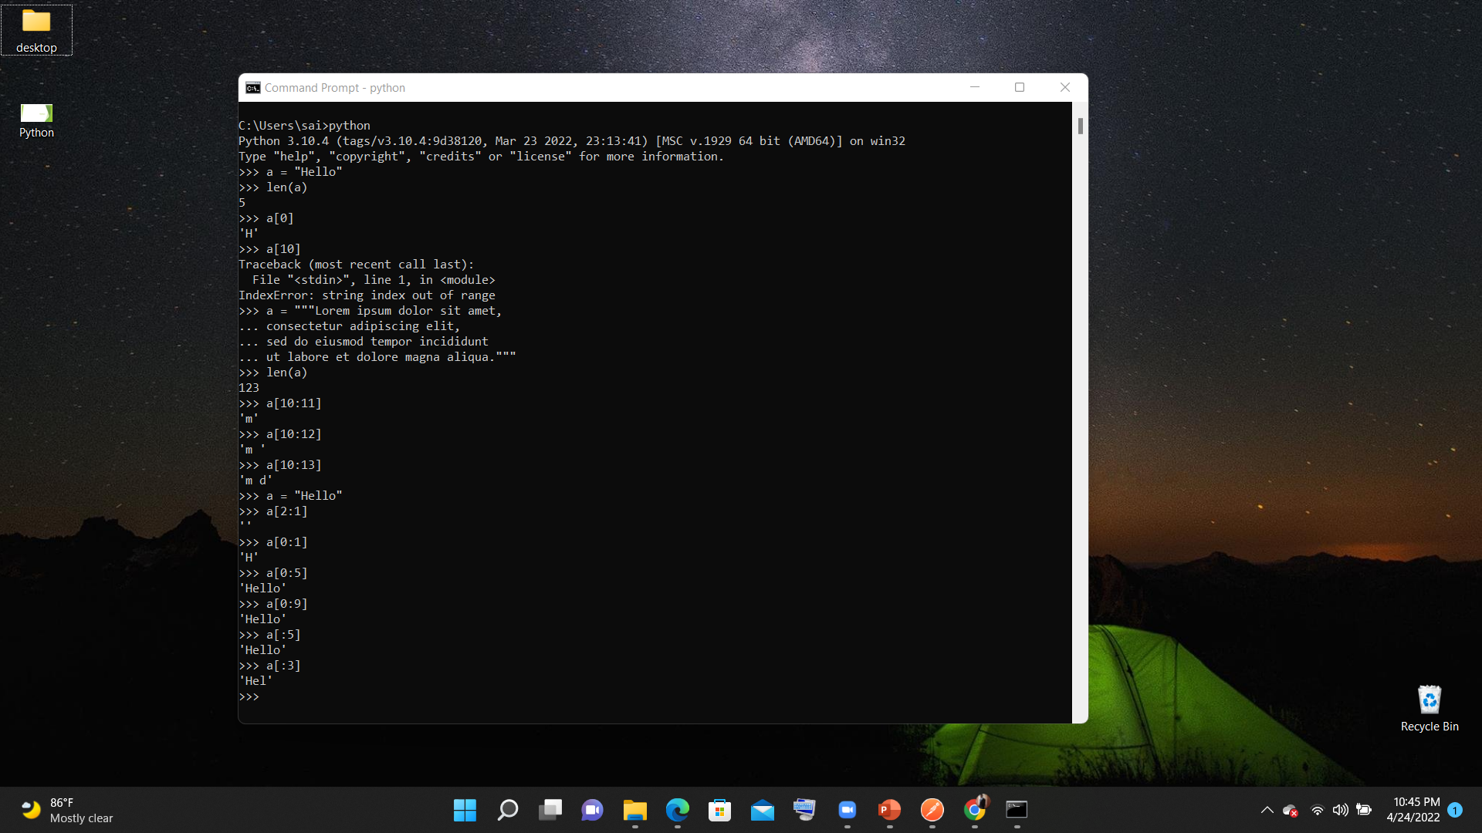
String

Slide 25
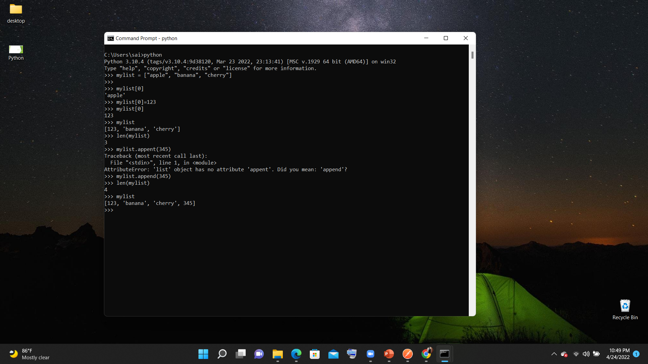
List

Slide 26
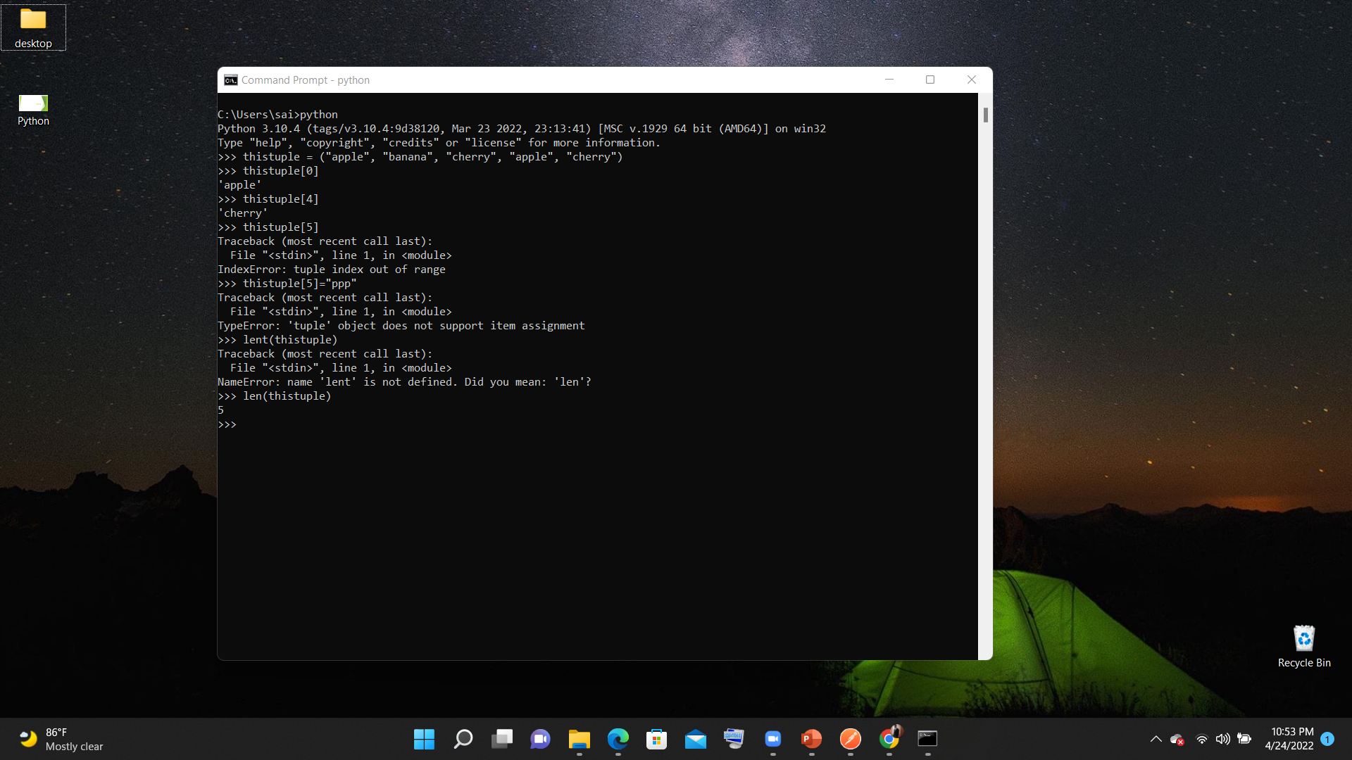
Tuple

Slide 27
type of Method
type() method returns class type of the argument(object) passed as parameter.
type() function is mostly used for debugging purposes.

Slide 28
Input-output
Input() (will take input from console)
Input(“message”)
A=int(input(“message”))
Print(a)
Print(type(a))
Print(“%d”,%(a))
Print(“hello”,”hai”,sep=“\n”)
Print(“hai”,end=“”)
print("a value is %d b value is %f"%(a,b))
print("a value is %d b value is %.2f"%(a,b))

Slide 29
Python operators
Arithmetic Operators
+,-,*,/,%,//
Assignment Operators
=,+=,-=,*=,/=,%= etc
Comparison Operators
==,<,>,<=,>=
Logical Operators
and,or,not
Identity Operators
in ,notin
Bitwise Operators
&,|,~,^,<<,>>

Slide 30
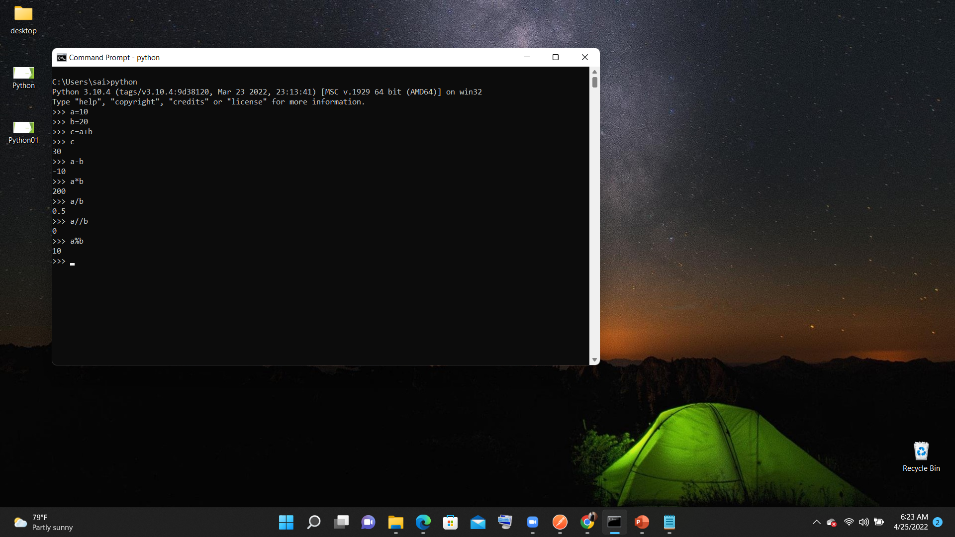

Slide 31


Slide 32
Cource content
Different types of Ides
First program with Python IDLE
Jupiter notebook
PyCharm
If blocks
For loops
While loops
Python functions

Slide 33
Python blocks
In Python, code block refers to a collection of code that is in the same block or indent.
This is most commonly found in classes, functions, and loops. You can where code blocks are because they are
Ex:-
If (a==b) :
print(“a”)
print(“b”)
Else:
print(“else statement”)
Print(“hello”)

Slide 34
if statemet
a = 200 b = 33 if b > a: print("b is greater than a")

Slide 35
If else statement
a = 200 b = 33 if b > a: print("b is greater than a")
else
print(“b is less than a”)

Slide 36
If elseif
a = 200 b = 33 if b > a: print("b is greater than a") elif a == b: print("a and b are equal") else: print("a is greater than b")

Slide 37
For loops
fruits = ["apple", "banana", "cherry"] for x in fruits: print(x)
for x in "banana": print(x)
fruits = ["apple", "banana", "cherry"] for x in fruits: print(x) if x == "banana": break
fruits = ["apple", "banana", "cherry"] for x in fruits: if x == "banana": continue print(x)
for x in range(6): print(x)

Slide 38
For loops
for x in range(2, 30, 3): print(x)
for x in range(6): print(x) else: print("Finally finished!")
for x in range(6): if x == 3: break print(x) else: print("Finally finished!")
adj = ["red", "big", "tasty"] fruits = ["apple", "banana", "cherry"] for x in adj: for y in fruits: print(x, y)

Slide 39
While loop
i = 1 while i < 6: print(i) i += 1
i = 1 while i < 6: print(i) if i == 3: break i += 1
i = 0 while i < 6: i += 1 if i == 3: continue print(i)

Slide 40
methods
A function is a block of code which only runs when it is called
You can pass data, known as parameters, into a function.
A function can return data as a result.
def my_function(): print("Hello from a function")
My_function()
def my_function(child3, child2, child1): print("The youngest child is " + child3) my_function(child1 = "Emil", child2 = "Tobias", child3 = "Linus")

Slide 41
Arguments & Return value
def my_function(a,b):
sum=a+b return sum
def my_function(*kids): print("The youngest child is " + kids[2])

Slide 42
Course content
String handling
File handling
Exception handling
Oops introduction

Slide 43
String functions
txt.endswith(".")
txt.find("welcome")
txt.isalnum()
Txt.isDigit()
txt.strip()
txt.startswith("Hello")
txt.swapcase()
txt.splitlines()
x = txt.split(", ")
txt.rstrip()
"#".join(myTuple)
txt.index("welcome")
txt.isdecimal()
txt.isnumeric()
txt.title()
txt.expandtabs(2)

Slide 44
Python built-in functions
Int()
Float()
Str()
Min
Max
Len()
Bool()
dict()
Type()
Open()

Slide 45
File Handling
How to open a file
Open modes(read,write,append,create(x))
Write into files
Copy one file to another
Deleting a file from filesystem

Slide 46
Opening a file
The key function for working with files in Python is the open() function.
The open() function takes two parameters; filename, and mode.
f = open("demofile.txt")
f = open("demofile.txt", "rt")

Slide 47
File open modes
"r" - Read - Default value. Opens a file for reading, error if the file does not exist
"a" - Append - Opens a file for appending, creates the file if it does not exist
"w" - Write - Opens a file for writing, creates the file if it does not exist
"x" - Create - Creates the specified file, returns an error if the file exists

Slide 48
Writing a file
To write to an existing file, you must add a parameter to the open() function:
"a" - Append - will append to the end of the file
"w" - Write - will overwrite any existing content
f = open("demofile2.txt", "a") f.write("Now the file has more content!") f.close()

Slide 49
Deleting a file
To delete a file we need to import os module
Samople code:
import os os.remove("demofile.txt")

Slide 50
Exception handling
Types of Errors
1. syntax error
2. logical error
3.Runtime Exception

Slide 51
Try-block
try:
... x = int(input("Please enter a number: "))
... break
... except ValueError:
... print("Oops! That was no valid number. Try again...")

Slide 52
Try with multiple exceptions
We can write multiple catch statements for a single try block
try:
...
except FirstException:
handle_first_one()
except SecondException:
handle_second_one()
except (ThirdException, FourthException, FifthException) as e:
handle_either_of_3rd_4th_or_5th()
except Exception:
handle_all_other_exceptions()

Slide 53
Finally
try:
f = open("file", "r")
try:
line = f.readline()
finally:
f.close()
except IOError:
<whatever>

Slide 54
Oops
Oops stands for object oriented programming
In Python, object-oriented Programming (OOPs) is a programming paradigm that uses objects and classes in programming.
It aims to implement real-world entities like inheritance, polymorphisms, encapsulation, etc. in the programming.
The main concept of OOPs is to bind the data and the functions that work on that together as a single unit so that no other part of the code can access this data.

Slide 55
OOps
Main Concepts of Object-Oriented Programming (OOPs)
Class
Objects
Constructor
Inheritance
Polymorphisms
Abstraction
Encapsulation

Slide 56
class
A class contains the blueprints or the prototype from which the objects are being created.
To define a class we use a keyword called class
Class <Name of the class>
Class myclass:
A=2
Def sayHello(self):
Print(“hello”)

Slide 57
object
To create an object we need to use:
Obj=ClassName()
Ex:- a=Student()

Slide 58
constructor
Python constroctor is the first method called when an object is called
We need to use __Init__ method to define a constructor
Ex:-
Class testClass:
__init__(self):
Print(‘this is constructor”)
We Have two types of constructor
Default constructor
Parameterized constructor

Slide 59
Constructor variables
Default constructor
Class testClass:
__init__(self):
Self.test=“this is Istance variable”
Parameterized constructor
Class testClass:
__init__(self,v1):
Self.test.v1

Slide 60
Self keyword
Self keyword is used to refer current object
We can create variable with self keyword
Ex:-
Class TestClass:
Def __init__(self):
self.a=100

Slide 61
Methods In class
Class Test:
_init(self,testv):
Self.v1=testv
Def Showv1(self):
Println(self.v1)

Slide 62
Inheritance
One of the major advantages of Object Oriented Programming is re-use. Inheritance is one of the mechanisms to achieve the same. Inheritance allows programmer to create a general or a base class first and then later extend it to more specialized class. It allows programmer to write better code.
Types of Inheritance
Single Inheritance
Multiple level Inheritance
Hierarchal Inheritance
Multiple Inheritance

Slide 63
Single Inheritance
One Derived class derived from one Base class
Base
Derived

Slide 64
Multilevel Inheritance
Base
Derived
Derived

Slide 65
Hierarchical Inheritance
Base
Derived A
Derived B

Slide 66
Multiple Inheritance
Base1
Base2
Derived Class

Slide 67
Abstraction
Abstraction is used to hide the internal functionality of the function from the users. The users only interact with the basic implementation of the function, but inner working is hidden. User is familiar with that "what function does" but they don't know "how it does.“

Slide 68
Abstract Class
@abstractmethod
def testAbstract(self):
None
Class should also extend ABC
We can have multiple Abstract methods in a abstract Class
We need to override all abstract methods to use code in abstract class

Slide 69
Data encapsulation
__ is used to restrict the accesss this is called private variables or method
Ex: __name=“test”
Ex:- def __add_two(a,b)

Slide 70
College management
Add students
Add teachers
Add teacher attendance
Add student attendance
Issue books
Return books
Generate hall ticket
Generate tc

Slide 71
Course contents
What is RDBMS
Installation of Oracle
ADDING a user
Different types of Commands DDL DML DQL

Slide 72
RDBMS
Rdbms:-sands for relational database management system
Here we store data in tables and we can have relations between tables
Database
Dbms
Different types of DBMS ORACLE MYSQL POSTGRES DB2 Sql server etc.

Slide 73
Installation of oracle
Download Oracle from oracle website
Oracle Database Express Edition (XE) Downloads
Extract zip file
Open setup.exe

Slide 74
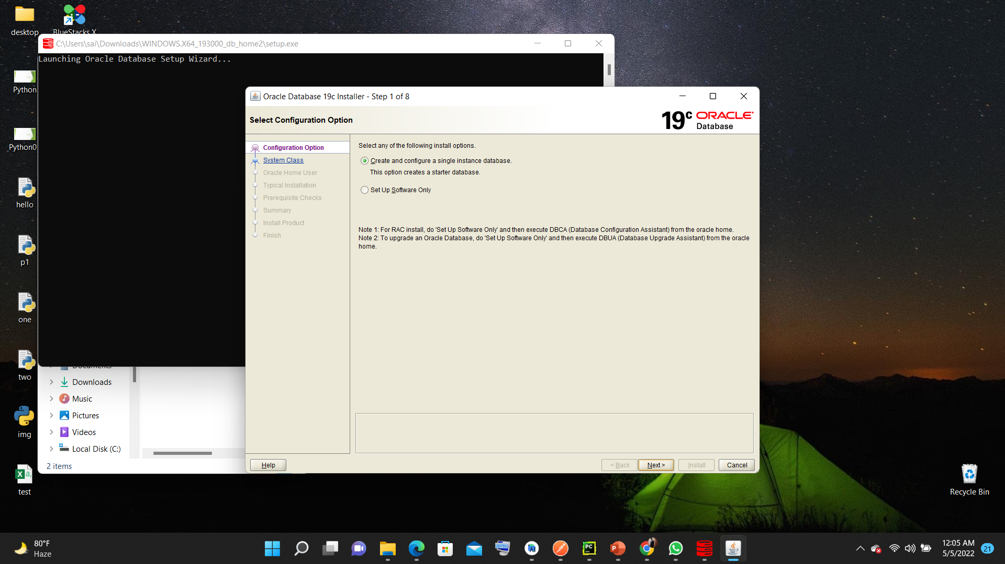

Slide 75


Slide 76
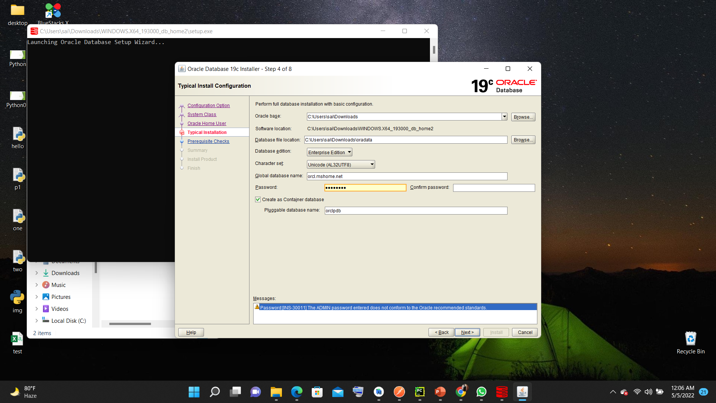

Slide 77
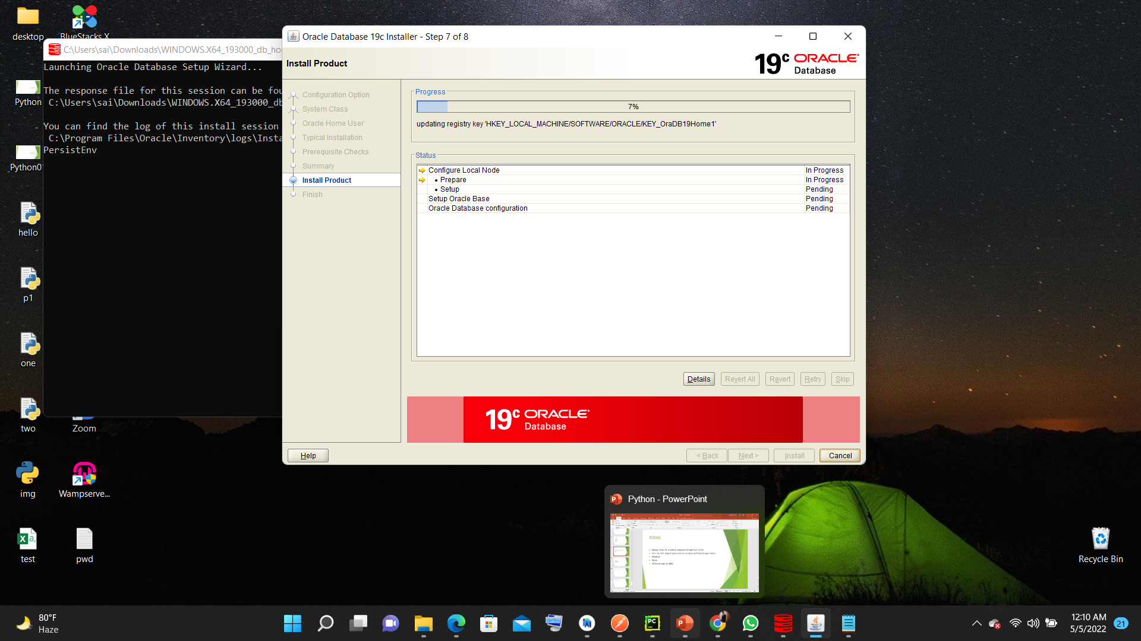

Slide 78
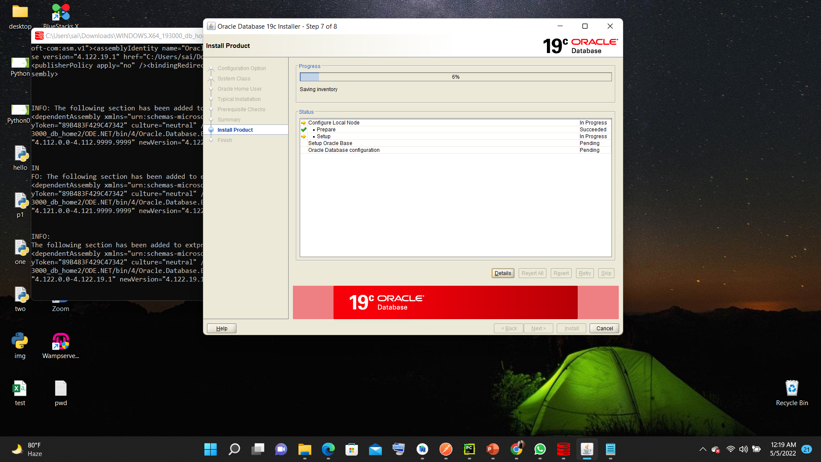

Slide 79


Slide 80
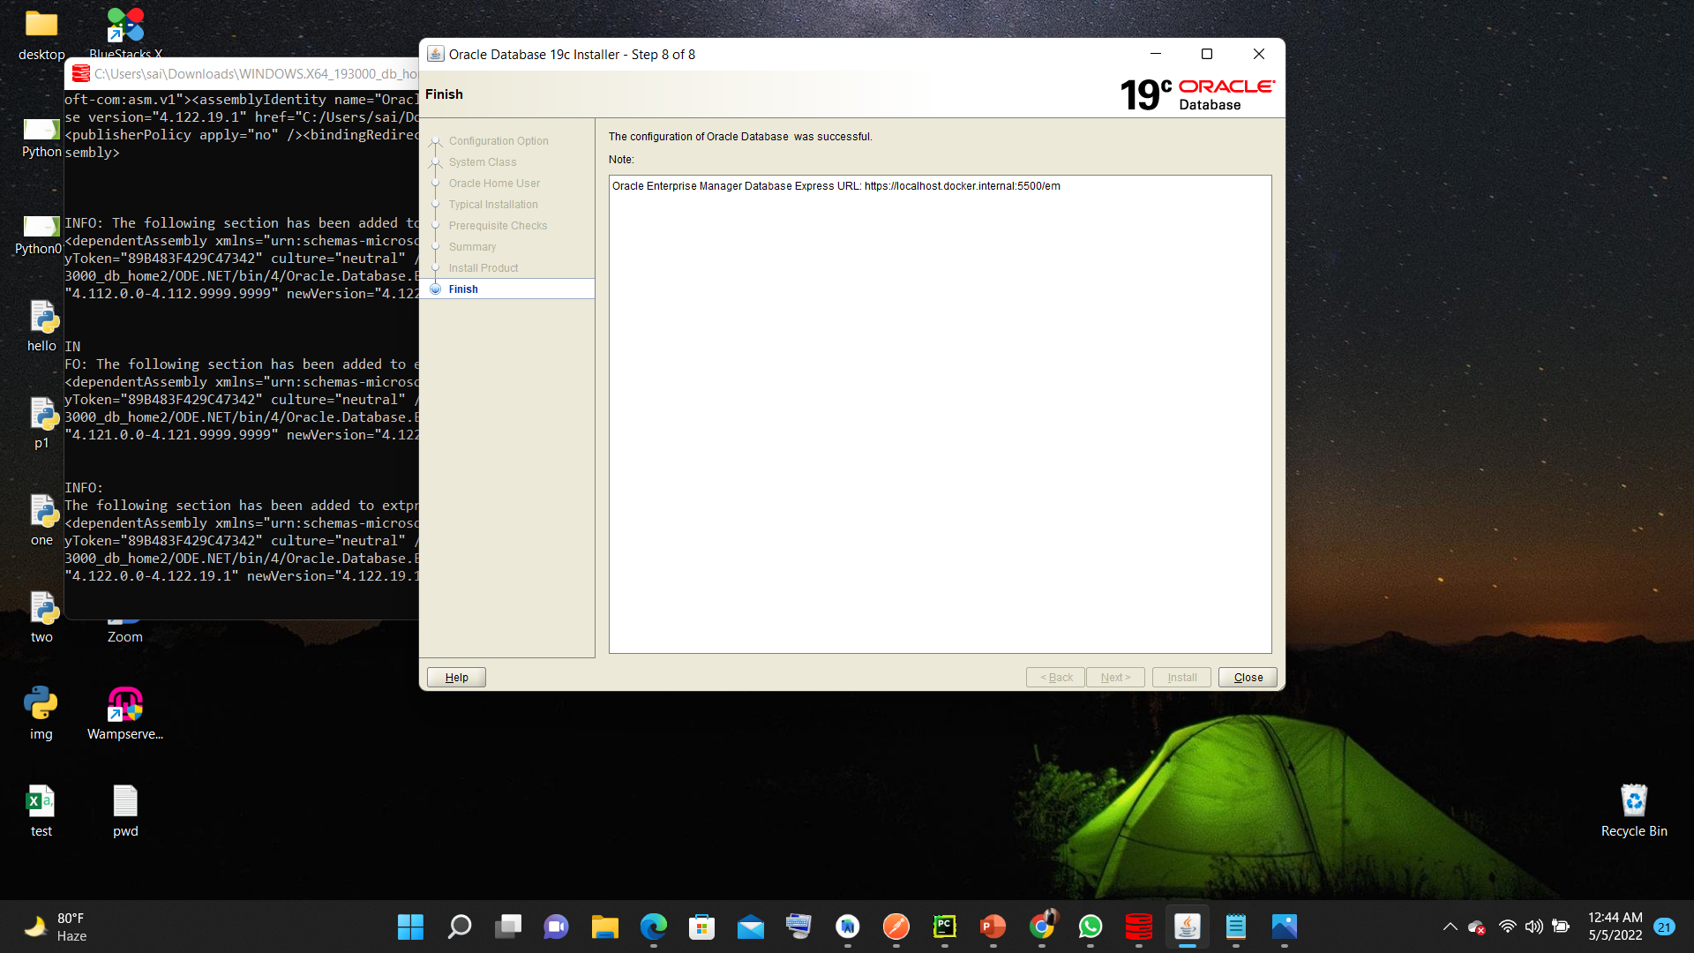

Slide 81
How to connect Oracle
Open command prompt
Type sqlplus username/password
Ex:-
Sqlplus admin/password

Slide 82
DBA access and create user
Sqlplus sys as SYSDBA
Enter password
To create user use
create user admin identified by password;
To grant permissions
grant all privileges to admin;
Change user conn admin/Shashi123

Slide 84
Sql commands and its types
Sql commands are following types:-
DDL commands
DML commands
DQL command
TCL commands
DCL commands

Slide 85
DDL Commands
DDL stands for Data definition commands
Data Definition Language helps you to define the database structure or schema.
CREATE
Ex:- create table <table_name>(column_name types,…);
DROP drop table <table_name>
ALTER Alter table <TABLE_NAME> COLUMN_NAME TYPE Alter table <table_name> modify column type
TRUNCATE truncate table <table_name>

Slide 86
Sql Datatypes
character datatypes
CHAR
NCHAR
VARCHAR2 and VARCHAR
NVARCHAR2
CLOB
NCLOB
LONG
NUMBER datatype
DATE datatype
binary datatypes
BLOB
https://docs.oracle.com/cd/A58617_01/server.804/a58241/ch5.htm

Slide 87
DDL commands Examples:
create table student(sid number,sname varchar2(20),s_fname char(20),phoneNumber Long);
Alter table student add column attendance number;
Alter table student modify s_fname varchar2(20);
Alter table student drop phoneNumber;
Describe student;
Drop table student
Truncate table student;

Slide 88
DML Commands
Data Manipulation Language (DML) allows you to modify the database instance by inserting, modifying, and deleting its data. It is responsible for performing all types of data modification in a database.
Here are some important DML commands in SQL:
INSERT
UPDATE
DELETE

Slide 89
Insert command
Syntax:-
INSERT INTO TABLE_NAME (col1, col2, col3,.... col N) VALUES (value1, value2, value3, .... valueN);
INSERT INTO TABLE_NAME VALUES (value1, value2, value3, .... valueN);

Slide 90
Insert Examples
insert into student(sid,sname,s_fname,phonenumber) values(1,'testname','test fname',98989898);
insert into student values(1,'testname','test fname',98989898);

Slide 91
Update command
Syntax:- Update table set column_name=values [where condition]
update student set s_fname='xyz’;
update student set s_fname='xyz’ where s_id=1

Slide 92
Delete command
Syntax:-
Delete from table_name where condition
Ex:- Delete from student where sid=1;
Delete from student ;

Slide 93
DQL command
Dql stands for Data query commands
Select :- Syntax:- select * from table_name; select <column_names..> from table_name; select <column_names> from table_names where condition

Slide 94
UNIQUE
CREATE TABLE student ( student_id int NOT NULL UNIQUE, FirstName varchar(25) NOT NULL, LastName varchar(25), Age int );
ALTER TABLE STUDENT ADD UNIQUE(age);

Slide 95
Not null and default
Syntax:-
Create table <tableName> (column_name TYPE Not NULL);
Create table <tableName> (column_name TYPE default ‘<value>’;
CREATE TABLE supplier( supplier_id numeric(10) not null, supplier_name varchar2(50) not null, contact_name varchar2(50) default ‘invalid’, CONSTRAINT supplier_pk PRIMARY KEY (supplier_id) );
Alter table <table> modify( column_name not null)
alter table supplier3 modify s_id_rel varchar2(20) default 'hello’;

Slide 96
Primary Key
In Oracle, a primary key is a single field or combination of fields that uniquely defines a record. None of the fields that are part of the primary key can contain a null value. A table can have only one primary key.
CREATE TABLE table_name ( column1 datatype null/not null, column2 datatype null/not null, CONSTRAINT constraint_name PRIMARY KEY (column1, column2, ... column_n)
);

Slide 97
Alter table add/drop a Primary key
ALTER TABLE table_name ADD CONSTRAINT constraint_name PRIMARY KEY (column1, column2, ... column_n);
Ex:- ALTER TABLE supplier ADD CONSTRAINT supplier_pk PRIMARY KEY (supplier_id)
ALTER TABLE supplier3 drop CONSTRAINT supplier_pk3 ;

Slide 98
CHECK Constraint
CREATE TABLE student ( student_id int NOT NULL, FirstName varchar(25) NOT NULL, LastName varchar(25), Age int CHECK (Age>=18) );
ALTER TABLE student ADD CHECK (Age>=19);

Slide 99
FOREIGN KEY Constraints
CREATE TABLE ATTENDANCEDETAILS (A_ID NUMBER PRIMARY KEY,A_SID NUMBER ,A_DAY NUMBER,A_PRESENT nUMBER,CONSTRAINT fk_column FOREIGN KEY (A_SId) REFERENCES STUDENT_DTL2(S_ID) );
ALTER TABLE Orders ADD FOREIGN KEY (student_id) REFERENCES student(student_id);

Slide 100
SEQUENCE
CREATE SEQUENCE STUDENT_seq START WITH 1;
dept_seq.NEXTVAL

Slide 101
functions
MAX()
MIN()
DISTINCT
Count
Sum
ABS
CEIL
FLOOR
ROUND (x, y)

Slide 102
functions
LOWER
UPPER
INITCAP
RTRIM
TRIM
SUBSTR
LENGTH
SYSDATE
NVL

Slide 103
Group By ,HAVING
select salary,count(employee_id) from employees group by salary
select salary,count(employee_id) from employees group by salary having salary>4000;
select MANAGER_ID ,count(employee_id) from employees group by MANAGER_ID having manager_id in (100,102,123);
select first_name, last_name, job_id, 12*(salary+nvl(commission_pct,0)) as "Annual Salary" from employees;

Slide 104
Auto commit
Set autocommit off;
Set autocommit on;

Slide 105
Like, in, between
Select * from student where student_name like ‘%test%’;
Select * from student where student_name in (‘abc’,’xyz’,’bcd’);
Select * from student where student_age between 10 and 12

Slide 106
Aliasing
select a.country_name from countries a;
select a.country_name test from countries a;

Slide 107
SQL joins
INNER JOIN (simple join)
LEFT OUTER JOIN
RIGHT OUTER JOIN
FULL OUTER JOIN

Slide 108
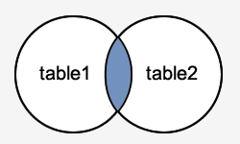
INNER JOIN (simple join)
SELECT columns FROM table1 INNER JOIN table2 ON table1.column = table2.column;
select a.country_name,r.region_name from countries a inner join regions r on a.region_id=r.region_id;
select a.country_name,r.region_name test from countries a,regions r where r.region_id=a.region_id;

Slide 109
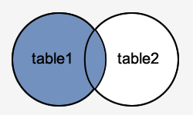
LEFT OUTER JOIN
SELECT columns FROM table1 LEFT [OUTER] JOIN table2 ON table1.column = table2.column

Slide 110
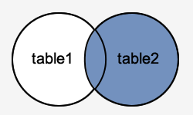
RIGHT OUTER JOIN
SELECT columns FROM table1 RIGHT [OUTER] JOIN table2 ON table1.column = table2.column;

Slide 111
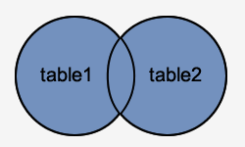
FULL OUTER JOIN
SELECT columns FROM table1 FULL [OUTER] JOIN table2 ON table1.column = table2.column;

Slide 112
functions
CREATE [OR REPLACE] FUNCTION function_name
[ (parameter [,parameter]) ]
RETURN return_datatype
IS | AS
[declaration_section]
BEGIN
executable_section
[EXCEPTION
exception_section]
END [function_name];

Slide 113
Function example
create or replace function adder(n1 in number, n2 in number)
return number
is
n3 number(8);
begin
n3 :=n1+n2;
return n3;
end;

Slide 114
Views
Create view <view_name> as select cols from table;’
Ex:- create view student_v as select s_id,s_name from student;

Slide 115
INDEX
CREATE INDEX index_name ON table_name(column1[,column2,...])
SELECT index_name, index_type, visibility, status FROM all_indexes

Slide 116
PROCEDURE
CREATE [OR REPLACE] PROCEDURE procedure_name
[(parameter_name [IN | OUT | IN OUT] type [, ...])]
{IS | AS}
BEGIN
< procedure_body >
END procedure_name;

Slide 117
Hello world procedure
CREATE OR REPLACE PROCEDURE greetings
AS
BEGIN
dbms_output.put_line('Hello World!');
END;
/

Slide 118
execute
execute greetings;
set serveroutput on size 30000;
Or
BEGIN
greetings;
END;

Slide 119
IN & OUT Mode Example 1

Slide 120
Executing procedure
DECLARE
-- variable to be passed to the procedure
rent NUMBER;
-- marks the start of procedure call
BEGIN
-- call procedure with rent as OUT parameter
calculateRent(1, rent);
--print the value of rent parameter
DBMS_OUTPUT.PUT_LINE('Rent = ' || rent);
END;

Slide 121
Pip
PIP is a package manager for Python packages, or modules if you like.
pip uninstall camelcase import camelcase c = camelcase.CamelCase() txt = "hello world" print(c.hump(txt))
pip uninstall camelcase

Slide 122
Mysql connection
import mysql.connector mydb = mysql.connector.connect( host="localhost", user="yourusername", password="yourpassword" ) print(mydb)

Slide 123
import mysql.connector mydb = mysql.connector.connect( host="localhost", user="yourusername", password="yourpassword", database="mydatabase" ) mycursor = mydb.cursor() mycursor.execute("CREATE TABLE customers (name VARCHAR(255), address VARCHAR(255))")

Slide 124
import mysql.connector mydb = mysql.connector.connect( host="localhost", user="yourusername", password="yourpassword", database="mydatabase" ) mycursor = mydb.cursor() mycursor.execute("SELECT * FROM customers") myresult = mycursor.fetchall() for x in myresult: print(x)

